Slide 1
Fellowships for Postgraduate Study
The United Kingdom and Ireland and More!

Slide 2
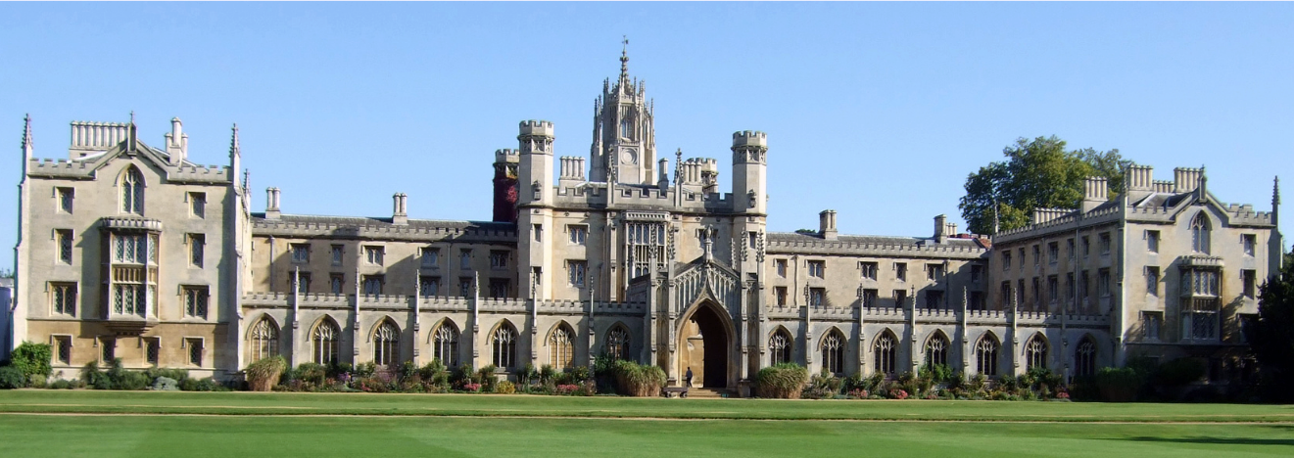
What are these fellowships?
Scholarships for graduate study
Make sure graduate degree is something you want/need
Time to do some soul-searching!

Slide 3
Professors, Academic Mentors
RC Resident Fellows
Friends and Family
Grad School Advisers in OCS
Professional Mentors
DUS/Major Adviser
TFs and Graduate Affiliates
Former fellowship winners
Who Should I talk to?
Don’t be shy!

Slide 4
They do things a little differently across the Atlantic…
Terminal Master’s degrees in 1-2 years
Two tracks: TAUGHT and RESEARCH
Test the waters before PhD
OR do a PhD/DPhil in 3 years…
New perspective: some disciplines look very different
Only a few hours of lecture/seminar a week
Libraries closed evenings and weekends
Degree courses have different names: MPhil, DPhil, MSt – use our “de-coding” advice
MORE focused… LESS structured…

Slide 6
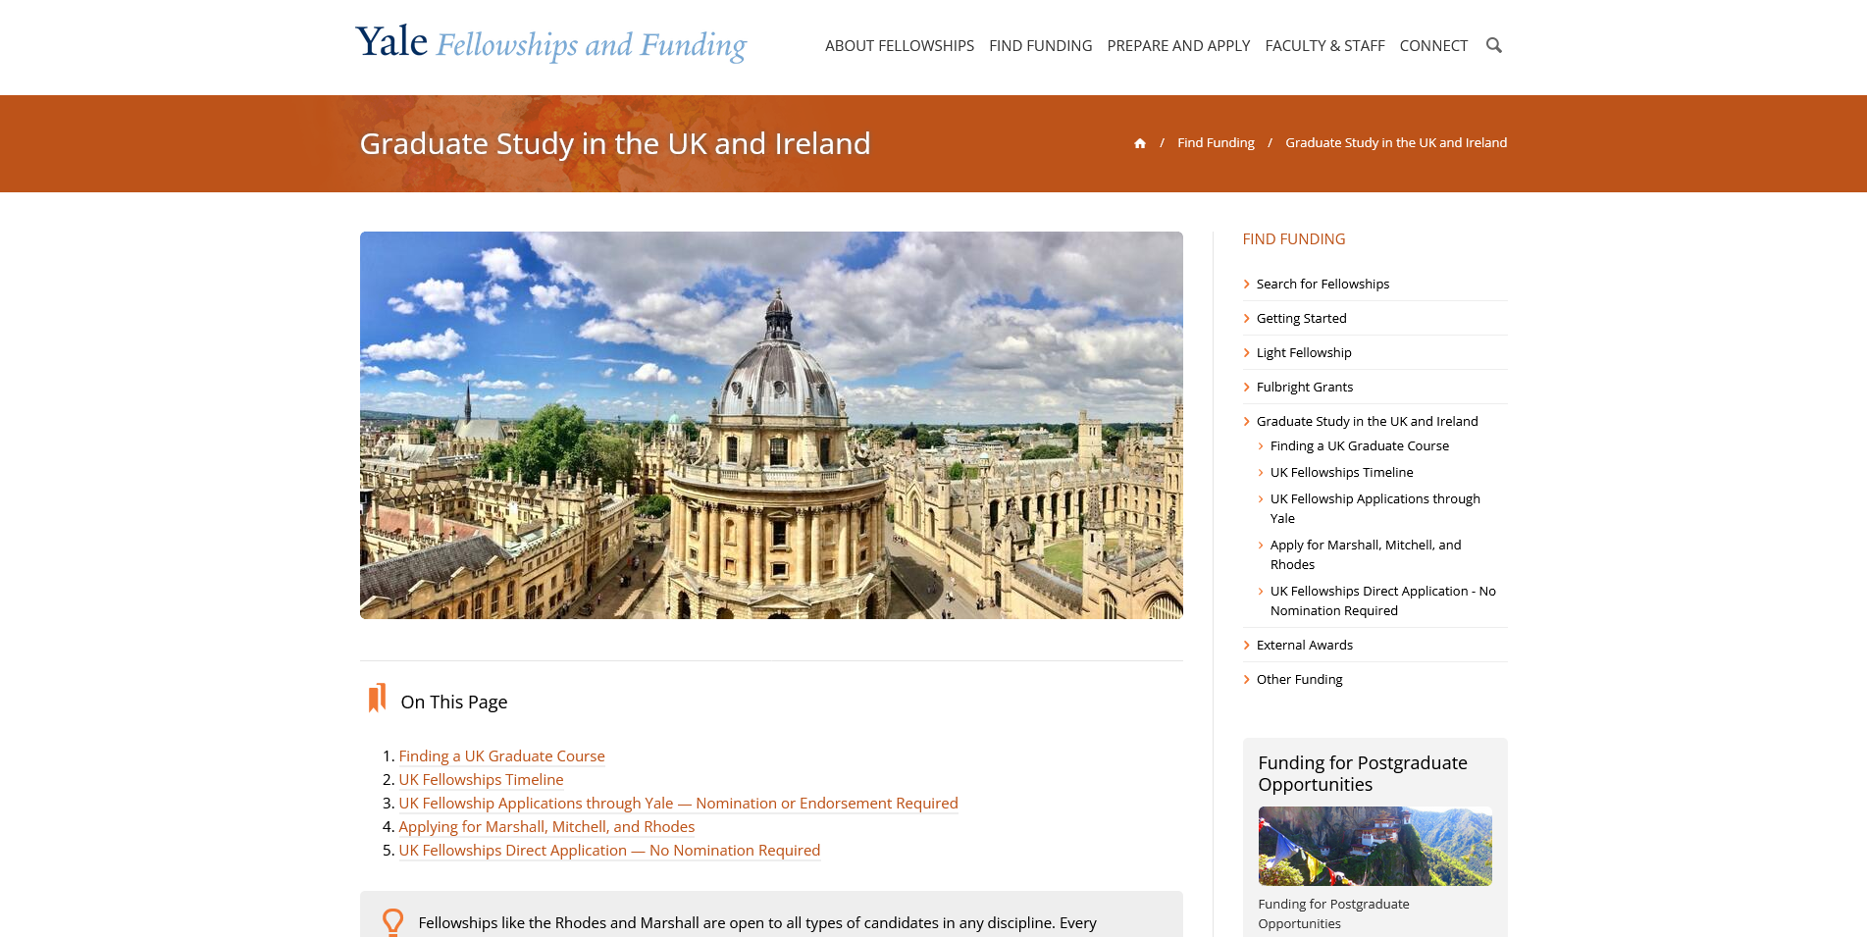
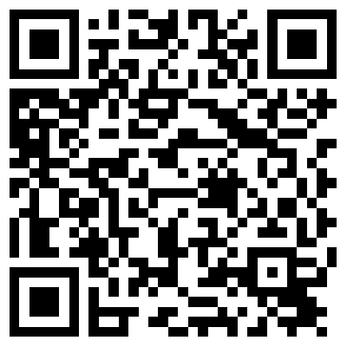
https://funding.yale.edu/find-funding/graduate-study-uk-ireland-0

Slide 7
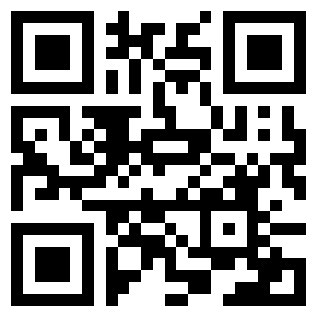
RESEARCH EXCELLENCE FRAMEWORK
Shows where the best work is being done at universities in the UK

Slide 8
Rhodes, Clarendon, Ertegun
Gates, Churchill, Paul Mellon, King’s, Chevening
Marshall, Fulbright
Henry
St. Andrew’s Graduate Scholarship
There are more fellowships than you might think!
These are just a few…
Only for study at Oxford
Only for study at Cambridge
For study at any university in the UK
For study at Oxford OR Cambridge – Yale students only
For study at any Scottish university – must have Scottish heritage!

Slide 9
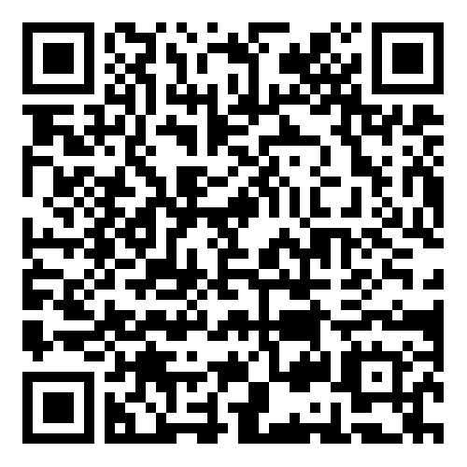
For study at Oxford
Up to 3 years of funding – OK to do a second BA!
US and Canadian Rhodes requires Yale nomination
22 other countries/regions to apply through
GLOBAL RHODES – deadline mid-June
What makes a strong candidate – what are the criteria?
Energy to use one’s talents to the full!
Truth, courage, kindliness, unselfishness
Moral force of character and instincts to lead
High scholarly attainments
NO HELP ALLOWED ON RHODES PERSONAL STATEMENTS AT ALL!

Slide 10
For graduate study at ANY university in the UK
1 year or 2 year Marshall – funding can be extended for 3 years
Requires Yale nomination
U.S. citizens only
What makes a strong candidate – what are the criteria?
High academic achievement – 3.8 min GPA to apply, compelling reason to be in the UK, deep familiarity with institution and degree choice
Leadership potential: Ability to deliver results, strength of purpose, creativity, self-awareness
Ambassadorial Potential: Knowledge of US/UK relations, ability to engage with others, self-confidence, transferrable extra-curriculars
You can get all the help that you want with the essays!

Slide 11
Fellowships for International Students
PAUL MELLON
HENRY
KING’S YALE

Slide 12
What else are they looking for?
Real knowledge of the institution AND the degree program
Commitment to make a difference in the world – seriousness of purpose
Evidence of deep thinking about who you are now
What is your case for the fellowship?
What is your narrative?
How will you connect the fellowship experience to what comes next?
LOGISTICAL STUFF: Time of graduation, age, citizenship

Slide 13
Now what? What’s the Yale Process?
FIRST: It doesn’t have to happen this year!
UPCOMING DEADLINES:
For Marshall/Rhodes – July first campus deadline
For Fulbright – late August campus deadline
For other fellowships – October to February deadlines

Slide 14
What should I be doing now?
Research your options!
Talk to possible recommenders
Make an appointment
Think seriously about Plan B, C, D…
Get organized – make a spreadsheet!
Start writing

Slide 15
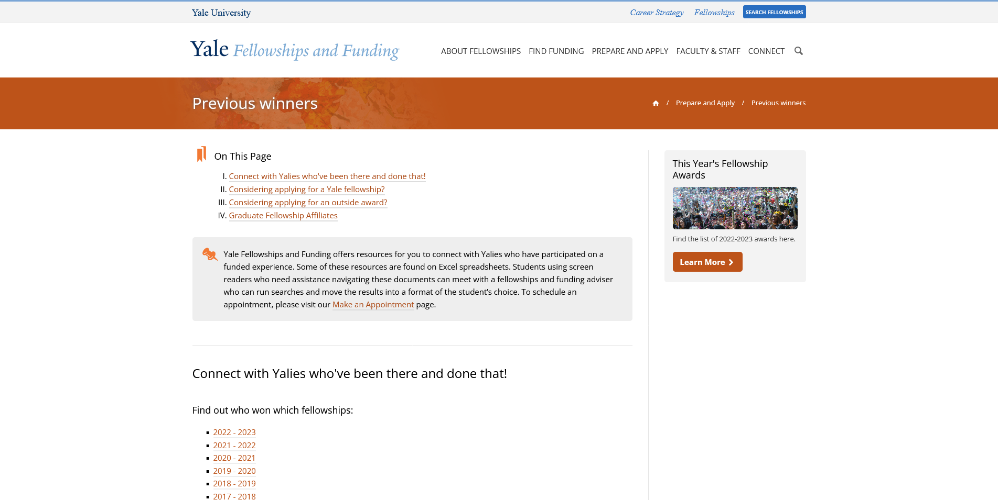
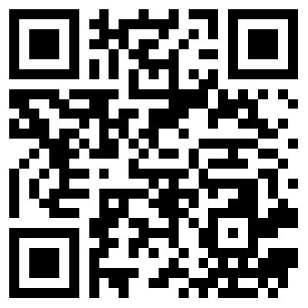
https://funding.yale.edu/previous-winners

Slide 16
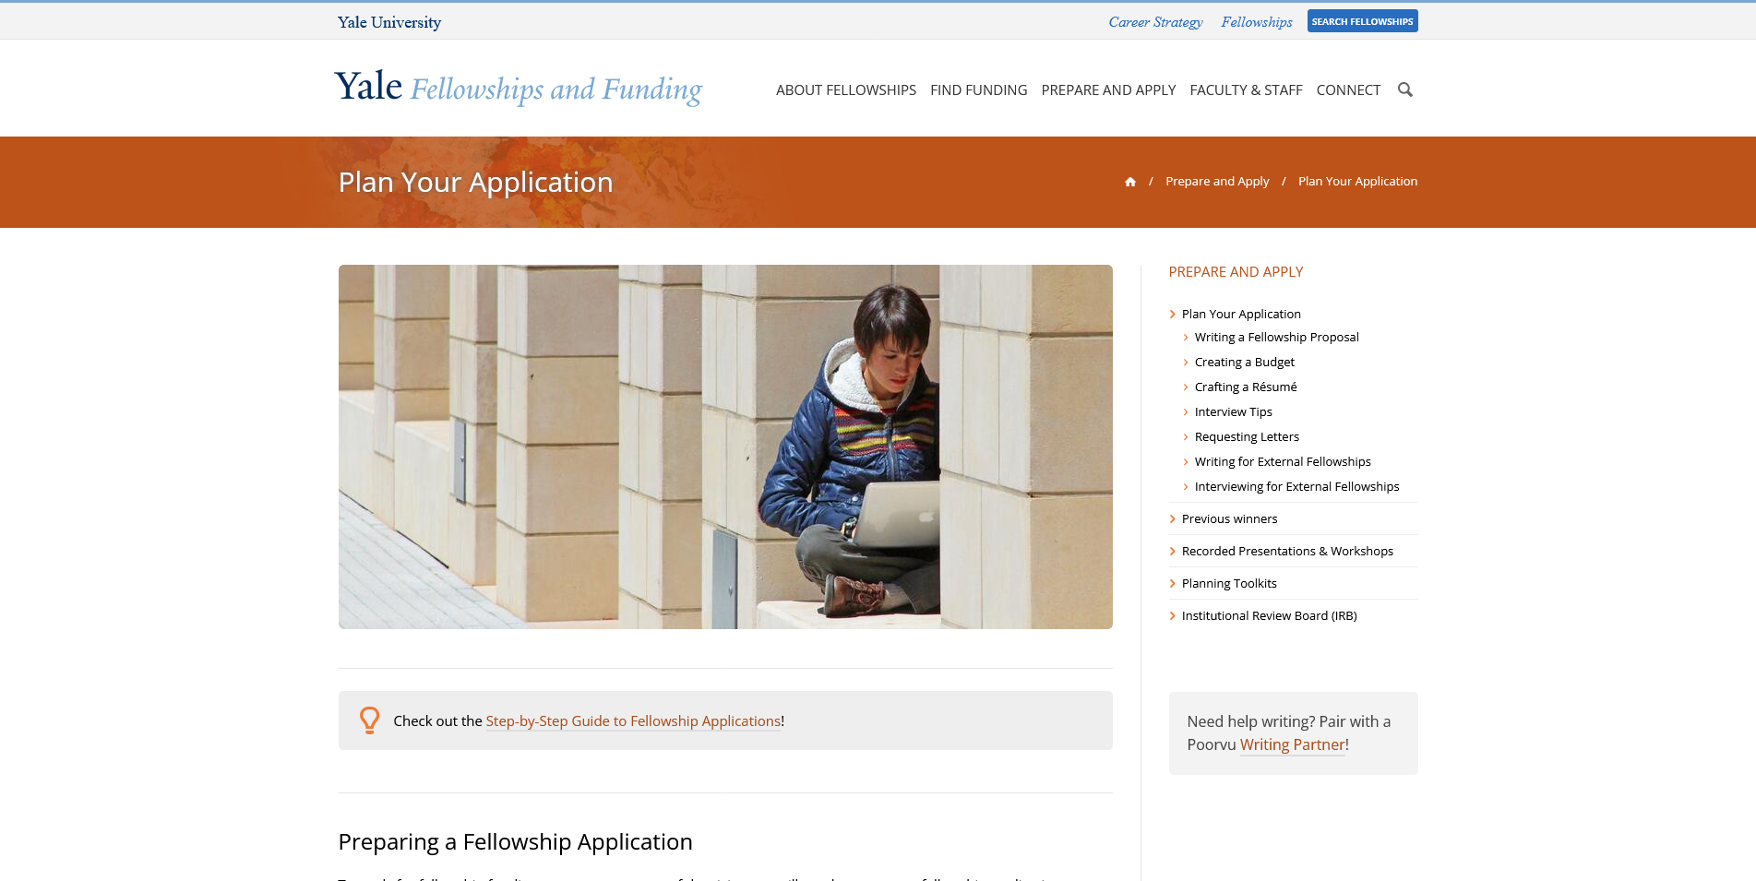
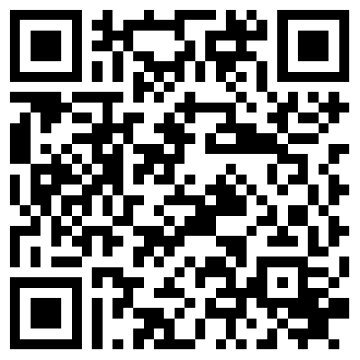
https://funding.yale.edu/prepare-apply/plan-your-application

Slide 17
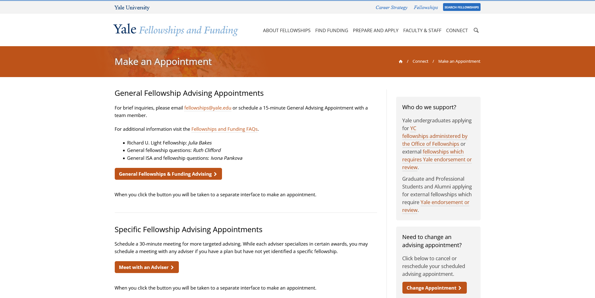
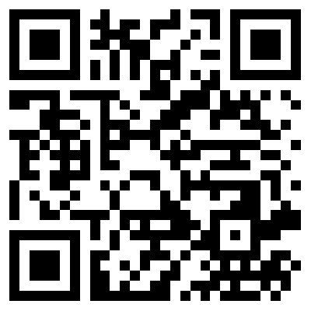
https://funding.yale.edu/contact/make-appointment

Slide 18
QUESTIONS?

