Slide 1
How to Download Applications
1. Log in using your NetID
https://yale.communityforce.com

Slide 2
2. Enter NetID and password
3. CAS log in
Downloading Applications Tutorial
Downloading Applications Tutorial

Slide 3
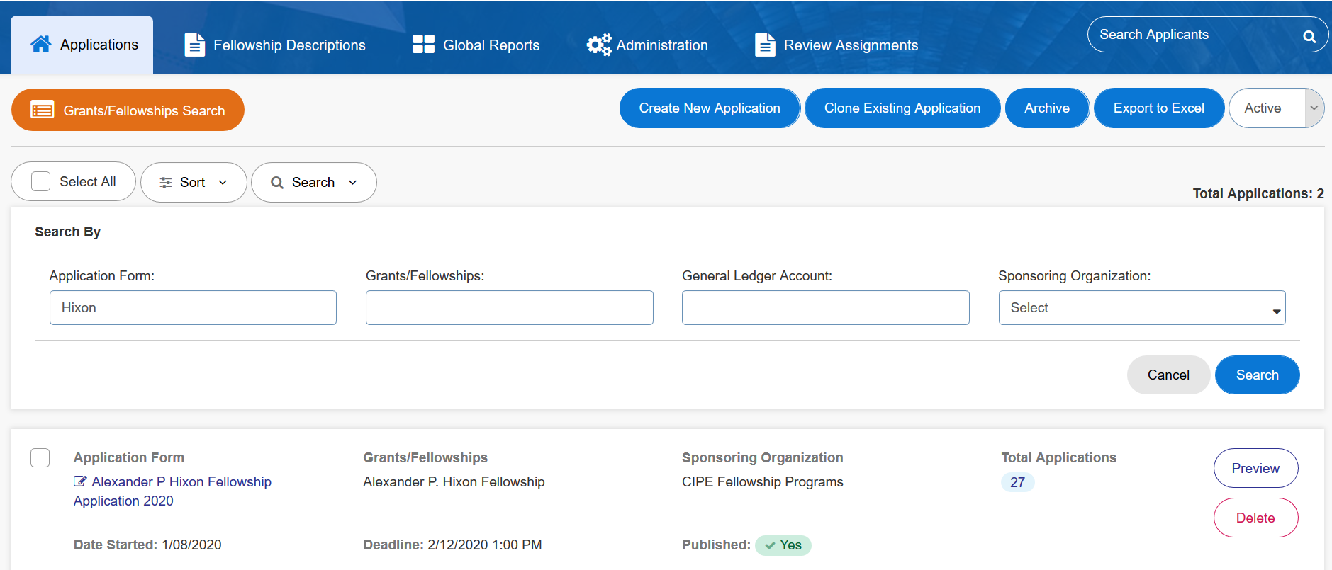
4. In the “Applications” tab, select the relevant application form.
Downloading Applications Tutorial
Downloading Applications Tutorial

Slide 4
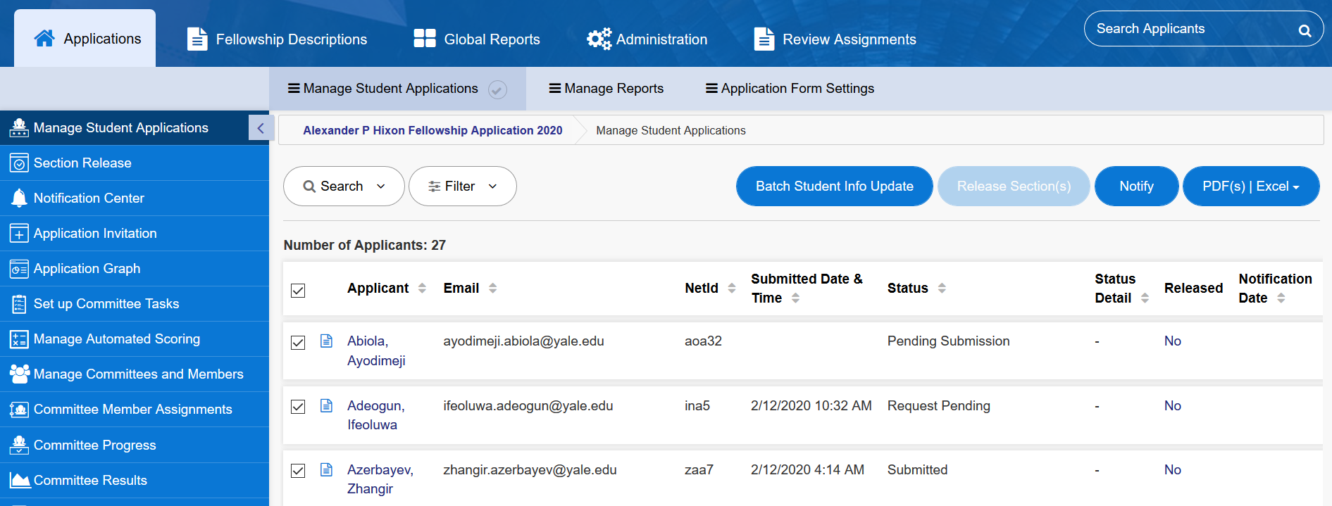
Status Definitions
Submitted: Application and letters of recommendation have been submitted and are complete
Request Pending: Application has been submitted and is complete but not all letters of recommendation/language evaluations have been submitted
Downloading Applications Tutorial
Pending Submission: An application was started but not completed or submitted
Downloading Applications Tutorial

Slide 5
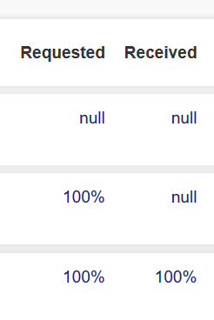
Optional: Scrolling all the way to the right will display the status of recommendations and language evaluations
No letter of recommendation or language evaluation has been requested or received
Letters of recommendation and language evaluations have been requested but they have not all been received
Letters of recommendation and language evaluations have been requested and received
Downloading Applications Tutorial
Downloading Applications Tutorial

Slide 6
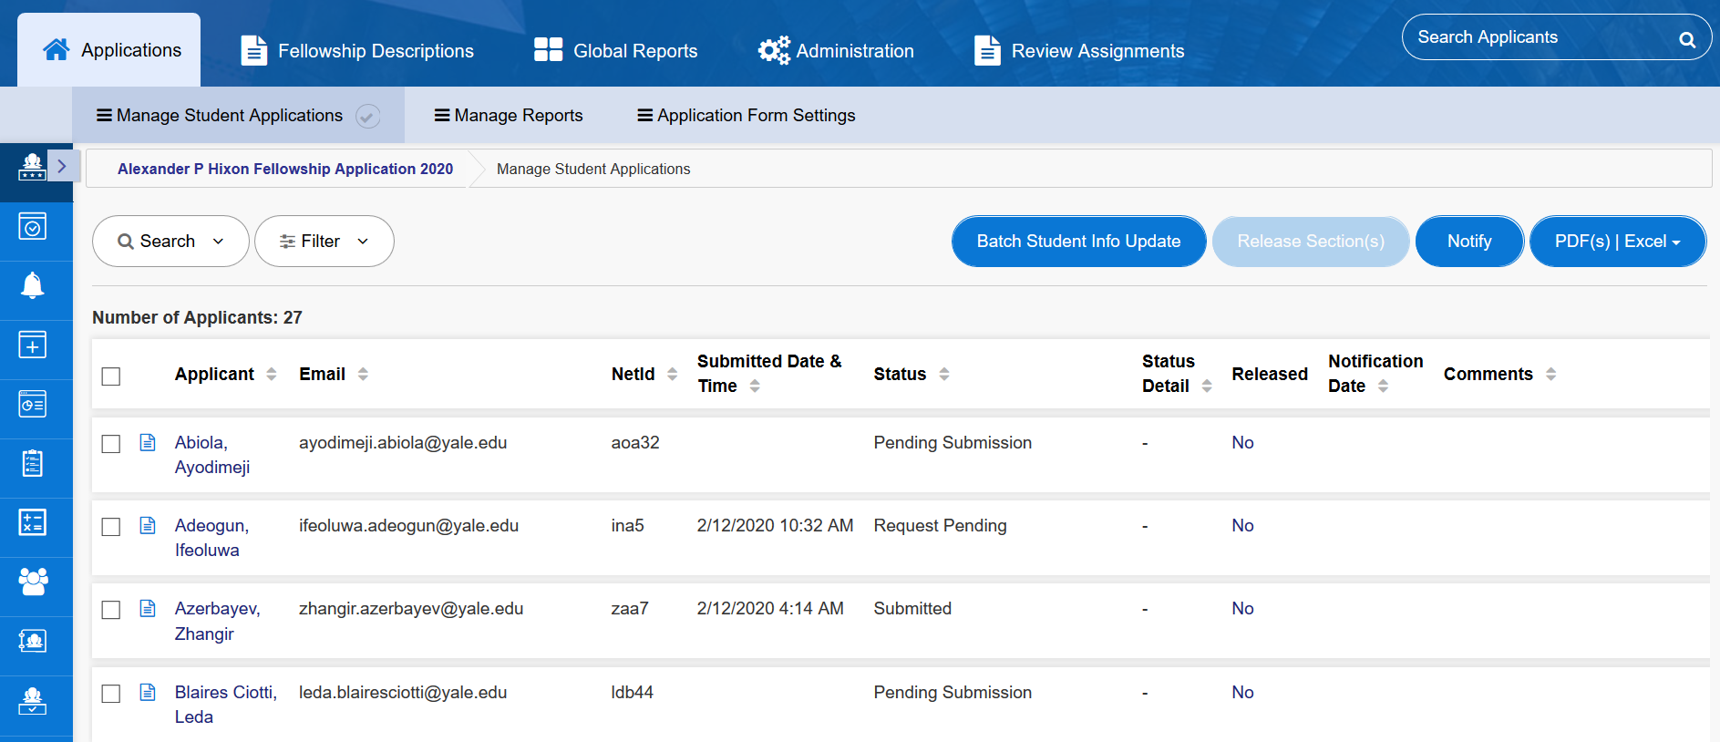
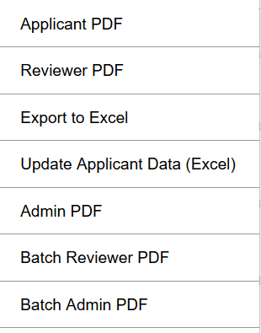
5. Check the boxes next to the application(s) you would like to download
6. Use the drop-down menu to select how you would like to receive the applications “Batch Reviewer PDF” allows you to download several applications at once.
7. The PDFs will be downloaded as a Zip file into your computer’s downloads folder.
Optional: select “All” to see all applications
Downloading Applications Tutorial

Slide 7
Questions? Please contact the Yale Student Grants team with any questions: studentgrants@yale.edu.

