Slide 1
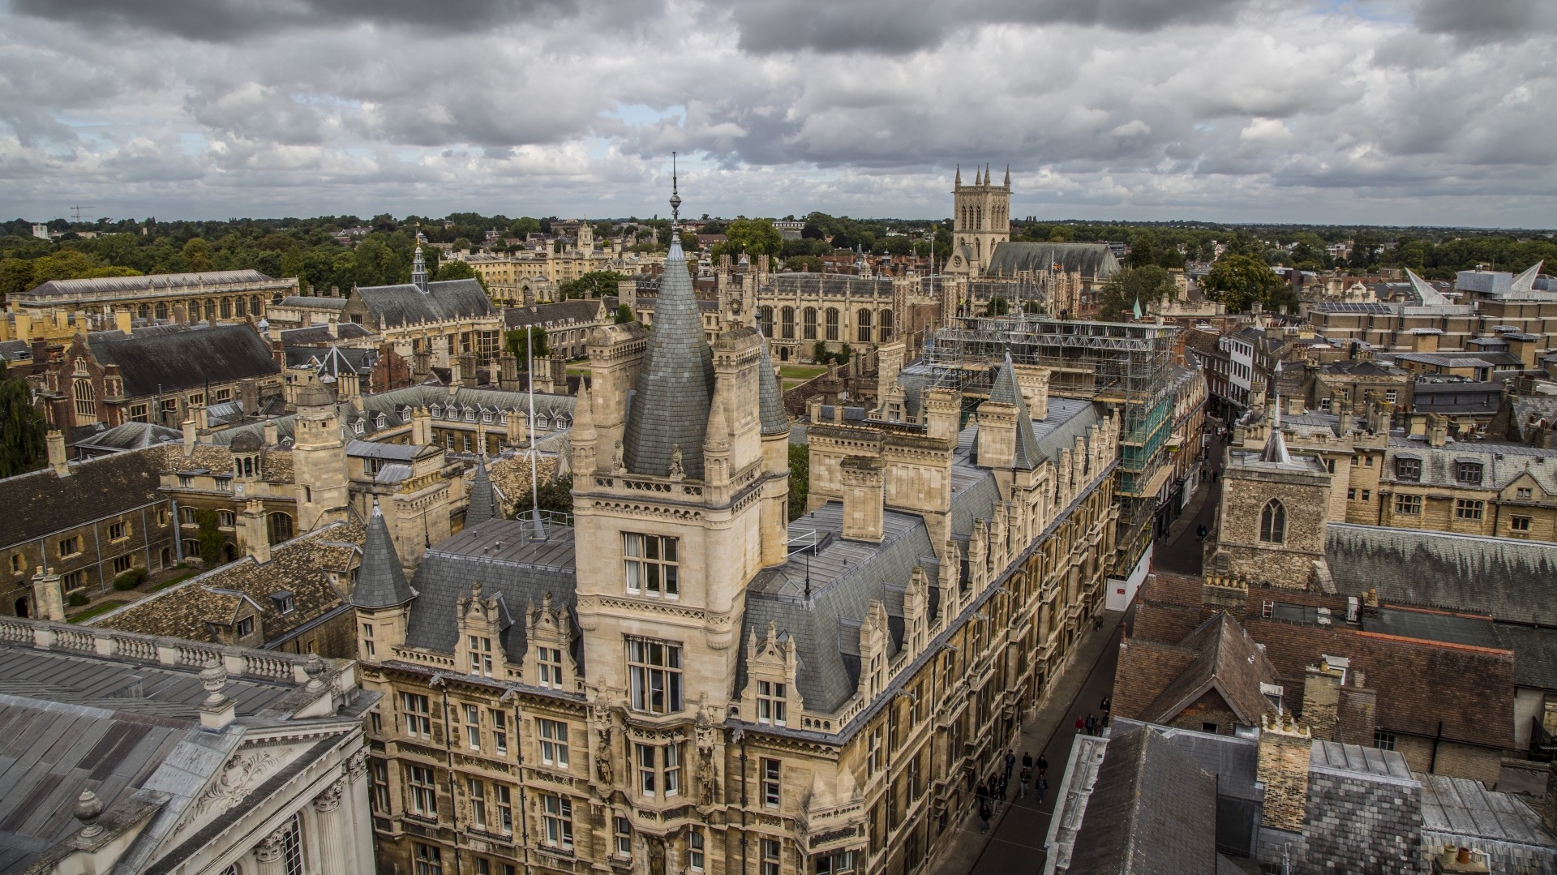
Selecting UK Universities for Graduate STudy

Slide 2
This session
Application Tips
Oxford, Cambridge, and London
Russell Group Universities

Slide 3
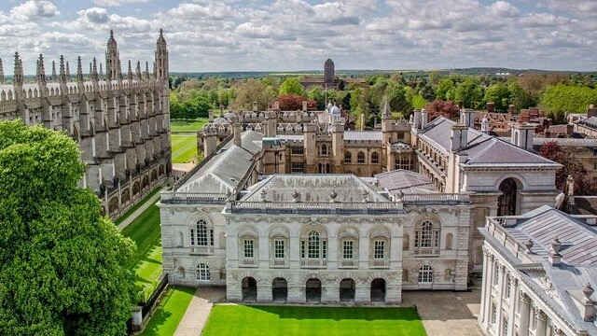
Oxford, Cambridge, and London

Slide 4
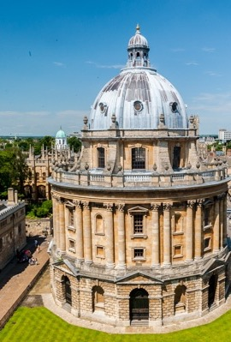
University of Oxford at a Glance
There are more than 26,000 students at Oxford, including 12,470 undergraduates and 13,920 postgraduates.
450 postgraduate courses received applications for year of entry 2022/23 (including part-time variants).
International students make up 46% of the total student body - more than 12,000 students - including 23% of undergraduates and 65% of graduate students.
Students come to Oxford from more than 160 countries and territories. The largest groups of international students come from the USA, China, Germany, Canada, India, Australia, Hong Kong, Singapore, Italy, France, and Netherlands.
For the 2023/24 academic year, the University expects to be able to offer around 1,000 full or partial graduate scholarships for new students.
(Source: https://www.ox.ac.uk/about/facts-and-figures/full-version-facts-and-figures)

Slide 5
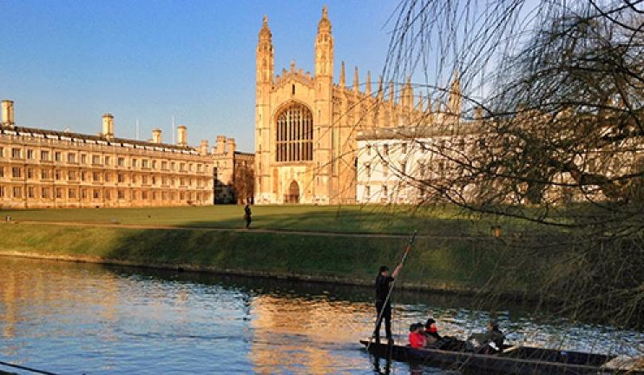
University of Cambridge at a glance
The University of Cambridge was founded in 1209. Cambridge is the fourth-oldest university in the world.
Undergraduates: 12,940
Postgraduates: 11,330
The University is made up of 31 constituent Colleges.
Cambridge is a globally diverse institution. Students come from more than 130 different countries.
Among Cambridge alumni and affiliates are121 Nobel Prize Laureates, 47 Heads of State, and 210 Olympic medallists.
“Silicon Fen”: The University of Cambridge sits at the heart of one of the world’s largest technology clusters. The Cambridge cluster is home to 5,300 knowledge-intensive companies. It is the birthplace of 23 businesses valued at more than $1 billion (£800 million).
(Source: https://www.cam.ac.uk/about-the-university/cambridge-at-a-glance)

Slide 6
Living in Oxford vs. Cambridge
Oxford is more urban (with colleges on city streets behind stone walls); Cambridge has a more rural feel (with colleges next to rivers and meadows with cows grazing)
Both cities have populations of around 150k, but Oxford is more densely populated
Both cities have wonderful arts and cultural offerings and a wide range of independent restaurants and shops
Cambridge has a slightly shorter direct train line to London (45m vs. 1 hour+)
Oxford is near the Cotswolds; Cambridge is near the Fens
Both are medieval cities with historic architecture and colleges that have distinctive histories, communities, and appearances

Slide 7
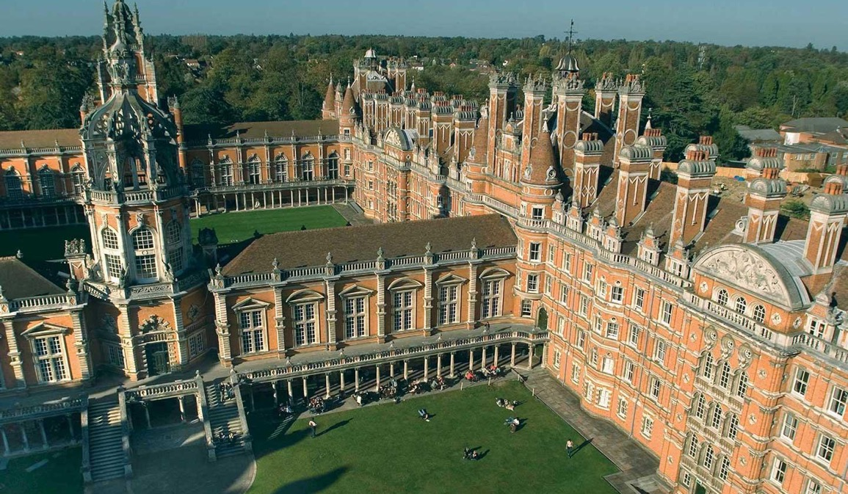
London Universities to consider
1. London School of Economics
2. Imperial College London
3. UCL (University College London)
4. King's College London
5. University of the Arts London
6. City, University of London
7. Queen Mary University of London
8. University of West London
9. SOAS University of London
10. Goldsmiths, University of London
(Source: https://www.thecompleteuniversityguide.co.uk/student-advice/blog/top-10-unis-in-London)

Slide 8
Russell Group Universities

Slide 9
Official Guidance for Marshall Scholarship Applicants
Marshall Partner Universities
“The Commission has established partnerships with leading institutions in the UK.
Marshall applicants are invited to indicate two preferred universities. Whilst Marshall Scholarships are tenable at any British University, expressions of interest in studying at universities other than Oxford, Cambridge and London are particularly welcomed. Candidates are especially encouraged to consider the Marshall Partnership Universities.”
(https://www.marshallscholarship.org/partners/partner-universities)

Slide 10
Choose the right course for you!
There are many world-class universities in the UK and Ireland.
24 Russell group universities (world-class, research-intensive institutions)
https://russellgroup.ac.uk/about/our-universities/
Times Higher Education world university rankings
https://www.timeshighereducation.com/world-university-rankings
QS world university rankings
https://www.topuniversities.com/university-rankings

Slide 11
Marshall Mondays
Marshall Mondays provide potential Marshall applicants with the opportunity to hear from our UK partner universities. Each session is led by a different UK university and will cover a variety of topics which might include an overview of the university, the application process steps, insight into studying in the UK, a lecture from an academic or a Q&A with current students. Further information about our partner universities can be found here on our website.
(Source: https://www.marshallscholarship.org/partners/marshall-Mondays)

Slide 12
RESEARCH EXCELLENCE FRAMEWORK
Shows where the best work is being done at universities in the UK

Slide 13
Application tips

Slide 14
Resources for preparing your application
Finding a UK graduate course:
https://funding.yale.edu/find-funding/finding-uk-graduate-course
https://www.marshallscholarship.org/apply/course-search
Reading reports from other Yalies:
https://funding.yale.edu/previous-winners
Planning your application:
https://funding.yale.edu/prepare-apply/plan-your-application
You can also pair with a Fellowships Writing Partner!

Slide 15
Culture Shock!
Applicants sometimes assume that living in the UK will be very similar to living in the US, because of the countries’ overlapping histories and shared language
They’re more different than you think!
As you’re figuring out whether you want to live in the UK – and where in the UK you’d like to live – you might do some of the things on the following slide
(These things can also help you to answer the “why the UK?” question you’re likely to encounter in fellowship interviews)

Slide 16
Getting to know British Culture
Read British news outlets (the BBC, The Guardian, etc.), and sign up for daily email newsletters (e.g. the BBC newsletter) – these are a good way to get a sense of what’s important / relevant / interesting / funny to people who live in the UK
Watch British television, from reality shows (Great British Baking Show, Great Pottery Throw-Down, etc.) to crime dramas and sitcoms – try to find shows set outside of London
Watch the UK broadcast of Eurovision, with Graham Norton’s wry commentary (or watch the Eurovision movie, in which he appears)
Read about Areas of Natural Beauty in the UK – there’s lots of variation in the landscape / climate
Keep in mind: Oxford and Cambridge have large communities of American students; that’s not always the case at other UK universities

Slide 17
How to fund Graduate Study in the UK?
Fellowships via Yale
Direct-apply fellowships
Department/University based funding for international students

Slide 18
Direct-apply fellowships
We have a whole page for that!
https://funding.yale.edu/find-funding/uk-fellowships-direct-application
The British council has a whole page for that!
https://study-uk.britishcouncil.org/
Make a list/spreadsheet
Check your eligibility
Note the deadlines
Use our resources

Slide 19
Other sources of funding
Check with the International Office of the University
Check with the department to see if they have scholarships
International Students – Ministry of Education of your country of origin
Google it!!

Slide 20
Check Deadlines for uk and Ireland graduate programs
Rolling admissions
Staged admissions
Make a spreadsheet!

