Slide 1
Retrieving Recommender Access Code
1. Log in using your NetID
https://yale.communityforce.com

Slide 2
2. Enter NetID and password
3. CAS log in
Retrieving Recommender Access Code Tutorial

Slide 3
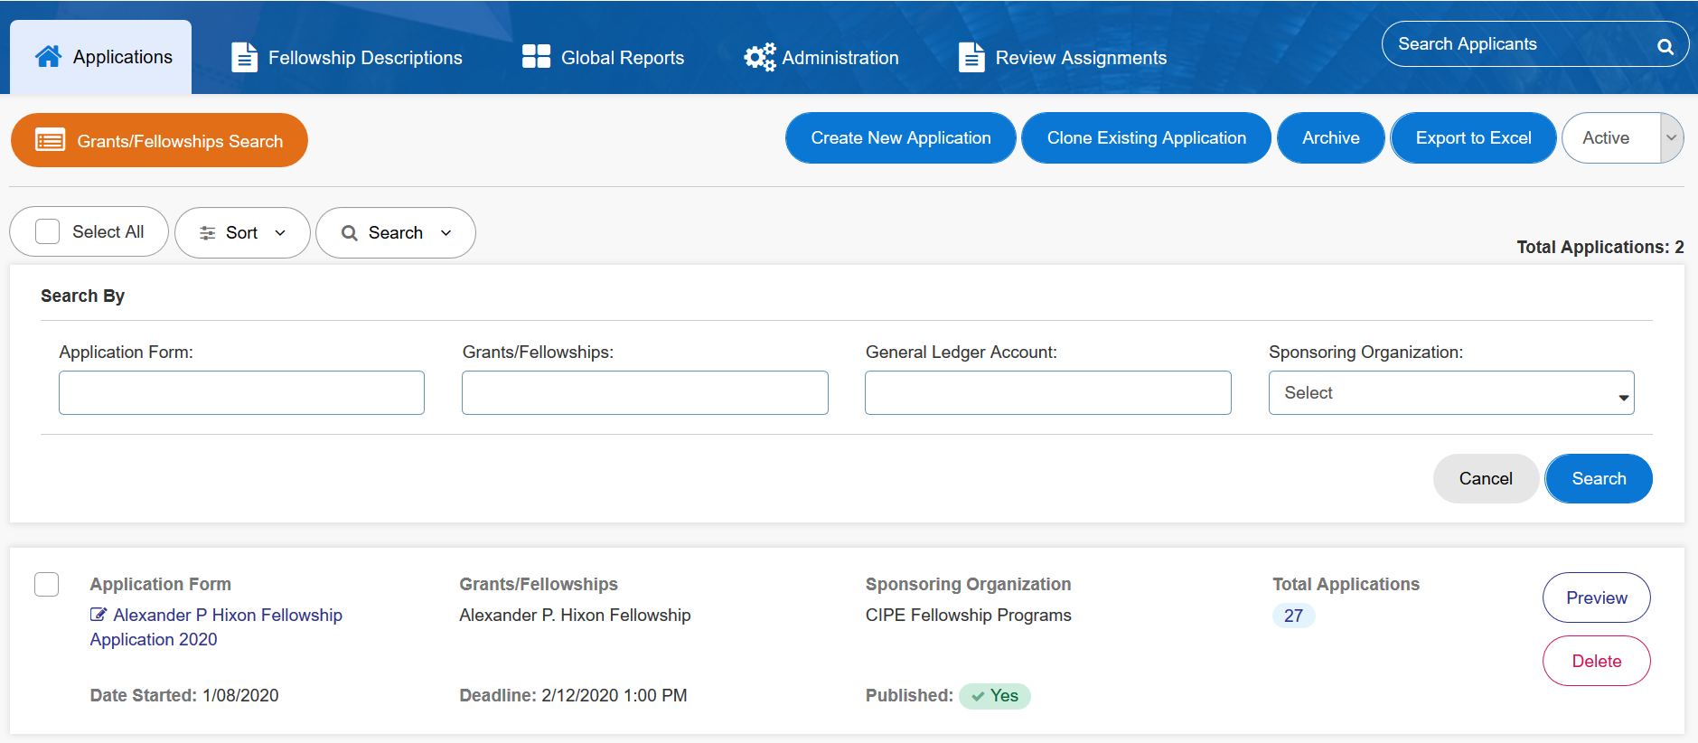
4. Search for your application form and click on it from the list.
Retrieving Recommender Access Code Tutorial

Slide 4
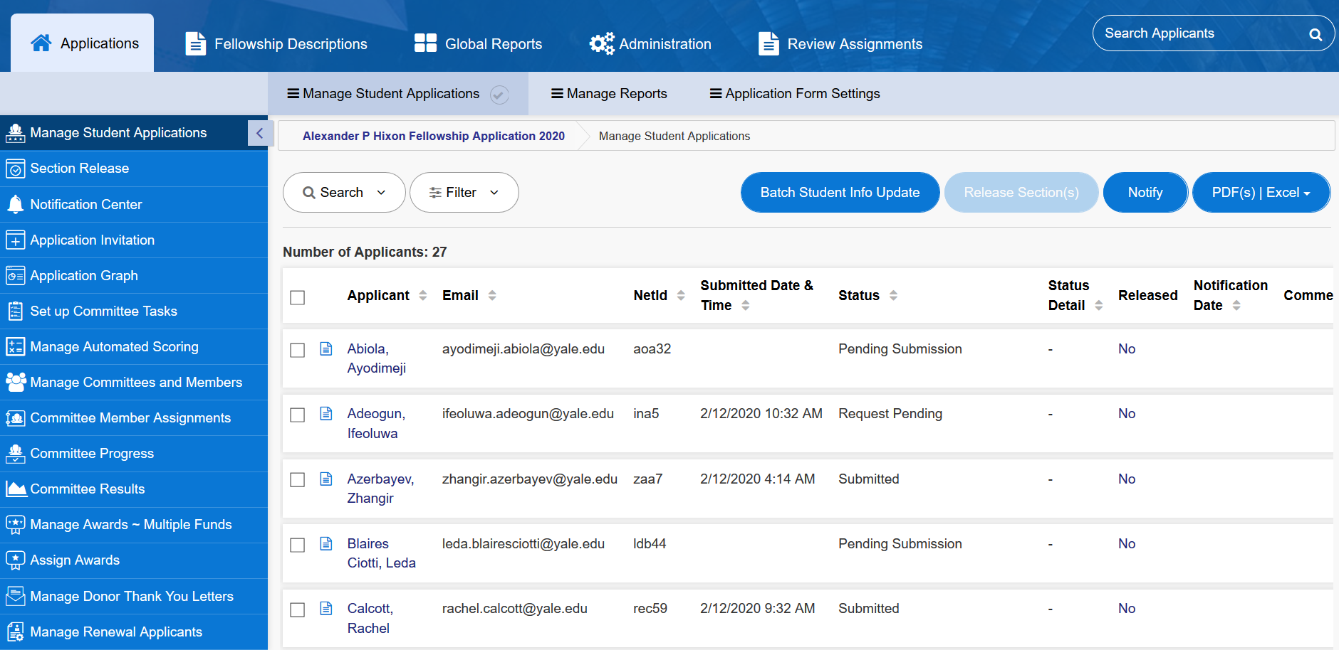
5. Select the applicant
Retrieving Recommender Access Code Tutorial

Slide 5
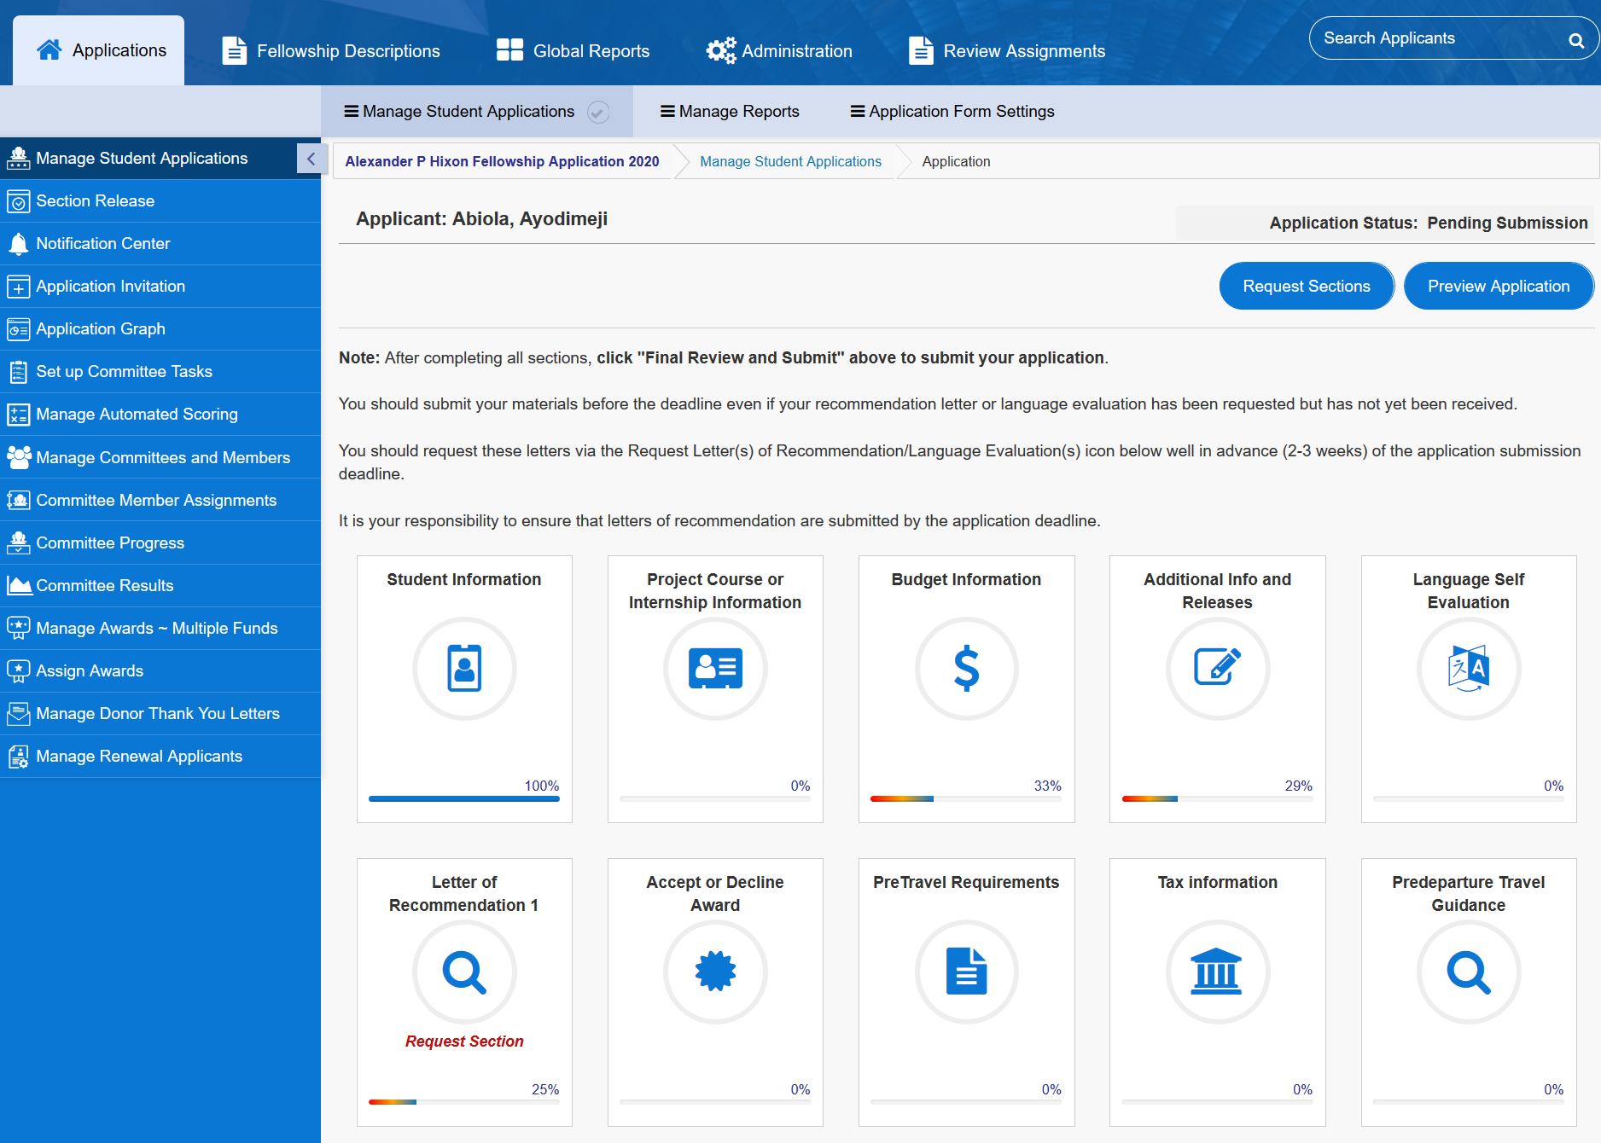
6. Click on “Request Sections”
Retrieving Recommender Access Code Tutorial

Slide 6
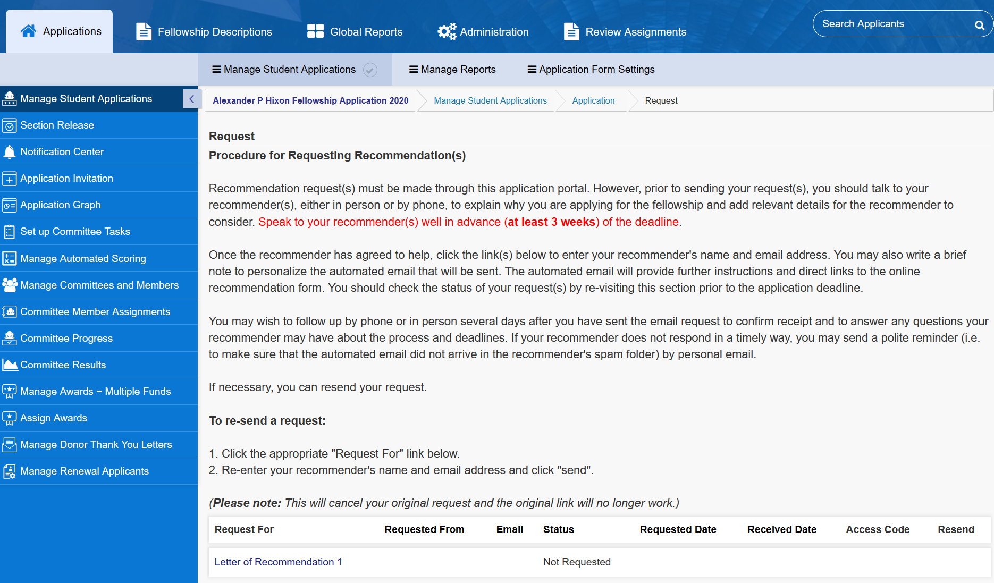
7. Find the correct recommendation request
8. Resend original request email or copy access code and email to recommender.
Retrieving Recommender Access Code Tutorial

Slide 7
Questions? Please contact the Yale Student Grants team with any questions: studentgrants@yale.edu.

