Slide 1
Interviewing for Fellowships
with the Office of Career Strategy

Slide 2
Preparation
Attire – plan ahead
Notebook and pen (if you like)
Know where you’re going!
Your entrance and handshake
Your demeanor
Managing nerves – normal nerves vs unprepared nerves!

Slide 3
Approach
Be prepared to share clear, relatable messages about your values and intentions
LISTEN
Before responding, take a beat, think, then respond
Conversation, not interrogation!
Be prepared for aggression, contrariness and being made to feel uncomfortable

Slide 4
Making a positive impression
Aim for a good conversation, taking into account:
Tone
Body language
Pace
Smile, eye contact, stay focused
Listen (don't let your nerves keep you from listening!)
Be honest - "I'm unsure" is perfectly acceptable
How you deal with pressure/aggression/contrariness
How you think on your feet
Don’t be tempted to say “good question” to each question!
Take cues from others' posture, tone and pace

Slide 5
Know…
Your application
How you plan to introduce yourself and share your “brand” (your story and strengths/experiences/values/ intentions)
How to relate your answers back to the fellowship and proposed academic program

Slide 6
Goals and Strategy
Your goal in the interview
To interest them in you and your work
The goal of the interviewer(s)
To pick scholars based on the criteria of the fellowship
What is your overall strategy?
Present 3-4 points/ideas that represent your authentic mission/purpose – show, don’t tell.

Slide 7
3 types of behavioral interview questions
Situational questions
Hypothetical questions
Application material-triggered questions

Slide 8
Situational interview questions
Related to actual situations faced. Reference your past experiences.
Purpose: These are meant to assess how you behave in certain situations
Typically start with “Tell me about a time….”
…..you led a team through a difficult situation
…..you successfully navigated ambiguity

Slide 9
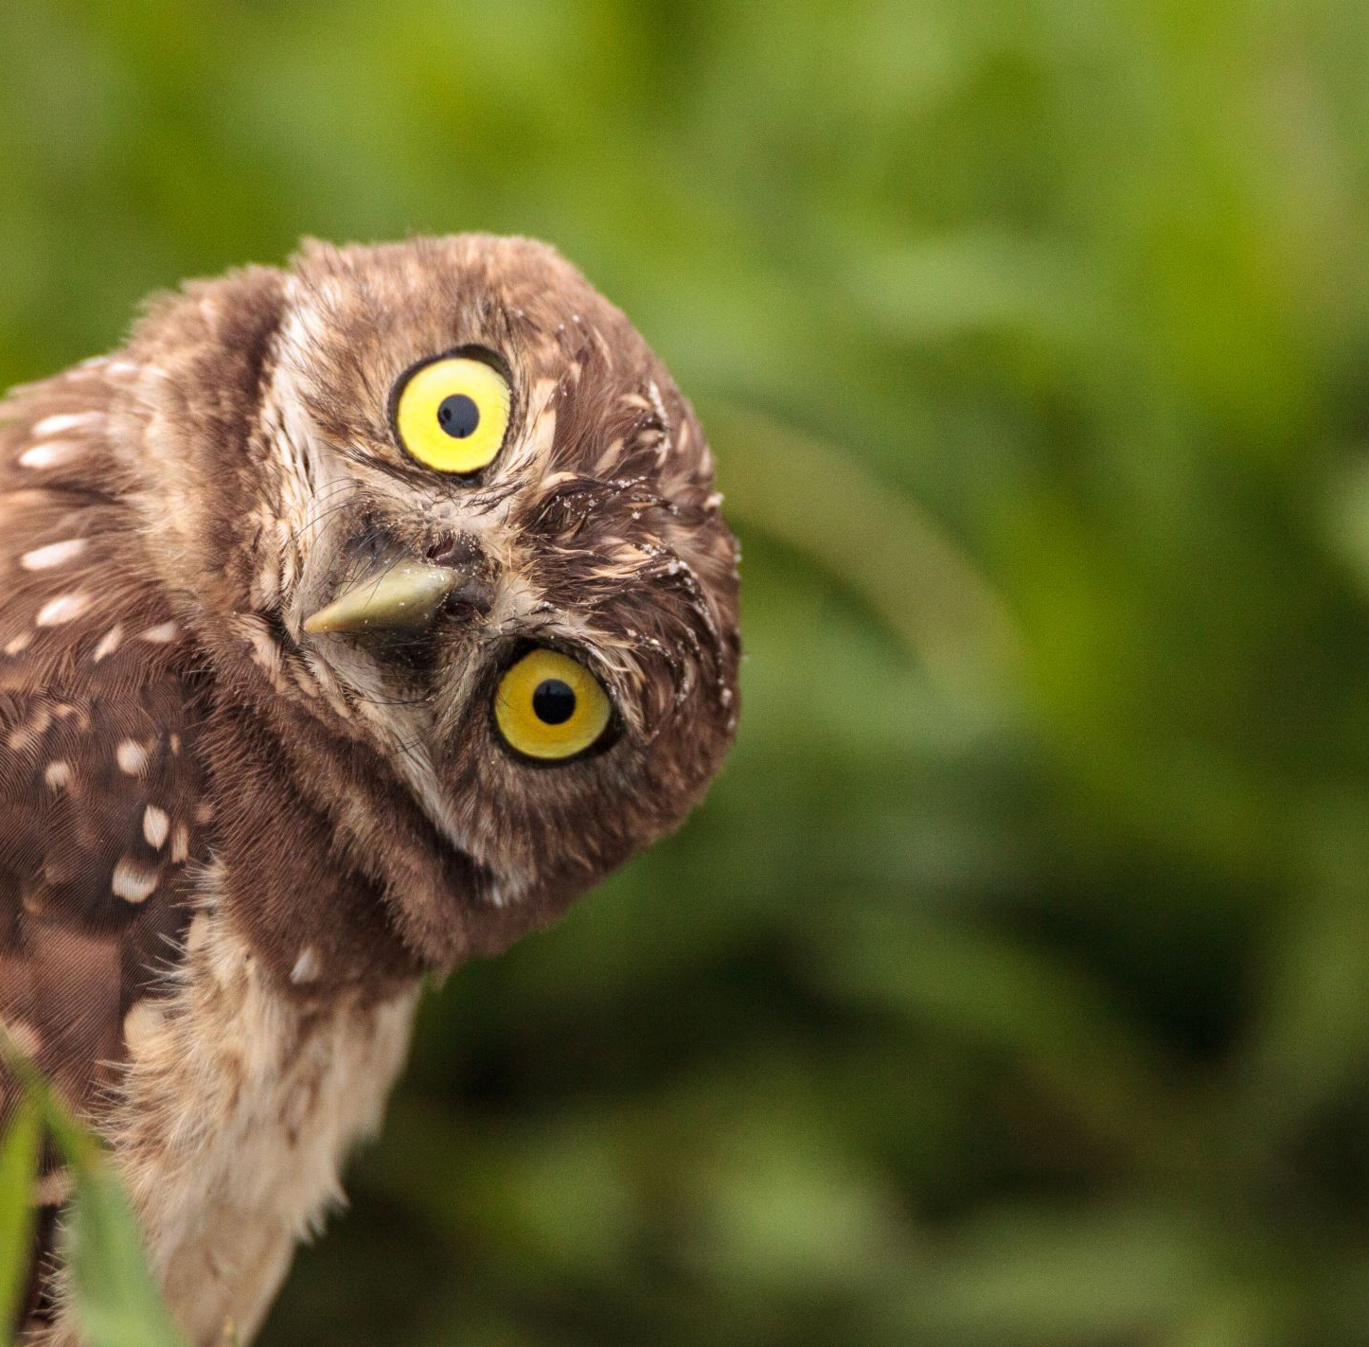
Hypothetical interview questions
Less specific but also related to the fellowship.
Purpose: To assess a trait or behavior related to the fellowship’s values
Typically start with “What if…..”
……you were not awarded this fellowship?
…..someone challenged you about the history of this fellowship?

Slide 10
Application based questions
Purpose: To touch on the why, the outcomes and your learning.
Typically start with “Tell me about…
….that B in your transcript
….the experience you had at XX non-profit

Slide 11
Sharing Your Motivational Story
Construct a confident and clear narrative that conveys your motivation and genuine interest in the fellowship
Your story will be unique to you and will reflect your path, interests and most impactful experiences
As part of your story, draw on your past experiences to explain ongoing and confirmed interest in your project or intended experience

Slide 12
Relevant academic work
“I studied history of science and medicine at Yale; my focus was on the relationship between public health and community action.
My senior thesis is on investigating the conflicts between the Yale hospital, the city of New Haven, and grassroots community groups during the civil rights era. This work has informed my decision to pursue a career in public health with a focus on addressing inequalities in under-resourced communities.”
Too general:
“I’m a history of science and medicine major!”
Unrelatable:
The title of your senior thesis or the name of your research lab

Slide 13
Your research purpose
“I conduct research in a microbiology lab at Yale.
I'm focusing on how we can improve the mix of microbes living in people's guts in order to prevent disease.
My research will inform strategies to treat hospital-acquired infections.”
Too general:
“I study immunobiology”
Unrelatable:
Too specific to mean anything to a non-expert in the field

Slide 14
Supporting Experiences
How do your story, academic background/research expertise, and supporting experiences make you a good fit for this fellowship and/or proposed academic program?
Show, don't just tell.
Possible supporting experiences (3-4 points/ideas):
Undergraduate experience (majors, classes, senior thesis)
Lab work
Independent Research
Industry Experience / Internships
Leadership roles
Community Involvement
Student Activities/Employment
Athletic pursuits

Slide 15
Accomplishment vignettes
What is an accomplishment vignette?
Used in behavioral interviewing to highlight specific skills or competencies
“Tell me about a time when you successfully overcame a challenge”
Vignettes provide proof of experience and are memorable

Slide 16
Structuring vignettes
Topic sentence (focuses you and interviewer on the skill/experience illustrated)
Background (sets stage, establishes problem or need, use “we”)
Actions you took (be specific, use “I”)
Results you achieved (quantify for context)

Slide 17
How do I prepare?
Prepare at least 2 vignettes for each point/idea you are showcasing as part of your brand
Each vignette should be 2-3 minutes long
Quality over quantity

Slide 18
Pre-interview prep
Why this fellowship, why you, and why now?
Tell me about yourself
What are your strengths?
What are your weaknesses?
What has led you to this point?
Situational questions (tell me about a time you demonstrated strength of character)
Context questions – from your resume/application materials
What if….questions (what if you didn’t get the fellowship?)
Do you have any questions for the committee?
Is there anything else you would like the committee to know?
Tips on interviewing Rhodes:
https://www.youtube.com/watch?v=T556Z-txmbE
Marshall:
https://www.marshallscholarship.org/apply/interviews

