Slide 1
Fellowships & Independent Activities Pre-Departure
Notes:
Hello and welcome to the Fellowships & Independent Activities Pre-Departure Presentation. Thank you for watching this presentation to ensure that you have the most productive, safe, and fulfilling experience for your summer or post-graduate year. Before we begin, we would like to remind you that this presentation is just a short part of the many pre-departure resources at your disposal, and we highly encourage you to explore them all. Each resource will provide helpful and valuable information on several aspects of your summer or post-graduate experience.
With that, let’s get started.

Slide 2
Investigate & Connect
Investigate
Travel Guides
Reports from past fellowship winners
U.S. State Dept. reports
Local newspapers
Weather.com
Connect
Peers from or at the destination
Your NGO/lab/other connections
Alumni (AYA)
Other students abroad (check MyCIPE)
Notes:
Even before you embark on your experience, you can take steps to best prepare yourself. Two of those steps are investigating and connecting.
Researching a space and an experience before you get there can really help you put your best foot forward. Explore local travel guides. On the fellowships website, you can find reports from pass fellowship winners where they will detail their experience in a specific space or even doing the same thing you might be doing! These are people who were in your shoes, so hearing their perspective can be invaluable. The U.S. State Dept also provides reports on spaces across the country and world to ensure you are prepared for any potential health considerations. Local newspapers can give you a good sense of what might be going on a space at the time that you are entering; they may also list local events you might want to participate in. And finally, you don’t want to find yourself in 20 degree weather without a coat or 80 degree weather with only thick sweaters; check out the weather in your destination using weather.com or the app on your phone.
In addition to investigating, there are many opportunities to connect before you embark on your own journey. See if there are peers from your destination that you can get insight from; they might even be able to tell you about some must-visit local spots! Are other people traveling to the same place? Get together so that you don’t feel like you’re embarking on this journey alone; you can exchange resources and tips to make sure you all feel even better about the trip. If you are working for an organization or lab, get in touch with them before you show up. Ask them questions about the environment and what to expect! Yale also has Alumni Associations all over the country and the world who are very happy to hear from current Yalies and recent grads. Find the closest one to you and see if you can stop by while you’re in the space or connect with some alumni in the area.

Slide 3
Taxes on Fellowships
See: IRS Publication 970
Contact the Yale Tax Office
(https://your.yale.edu/work-yale/financial-management/tax-compliance-and-planning)
Let your parents / tax preparer know!
Notes:
Now, before we get into some other things, we want to make sure we cover taxes very quickly. Although we are not tax experts in the Fellowships, Career Strategy, Yale Summer Session or Study Abroad offices, we do want to make sure you are aware that there may be tax implications to your experience, regardless of your destination location. Please See IRS Publication 970 and contact the Yale Tax Office with any questions. You don’t want to find yourself in an unexpected tax situation later on so make sure you do your due diligence now.

Slide 4
Responsibility
Responsibility to those at your destination
Think about implications of your work to the people living in your destination
Consider ethical and safety concerns
Think about other peoples’ perception of you in that space
How will you respond consciously and responsibly?
Treat others with respect
Responsibility to the fellowship donor(s)
People have supported you in your endeavor, so make sure you are staying on task and meeting your goals
Think about what you’ll put in your eventual required report
Responsibility to yourself
Open yourself up to a new and different kind of learning
Become the ethnographer of your own experience
How will you build on this experience and stay connected?
Notes:
As we move into the next phase of the presentation, One of the most important things to think about while you are on your experience is responsibility. Responsibility to those at your destination; responsibility to the fellowship donors, and responsibility to yourself.
You should consider the implications of your work, ethical and safety concerns, and the perception of you in that space.
Donors are part of the reason you are able to embark on your endeavor; it is important to stay on task and consider what you will share in your final report at the conclusion of your experience.
And lastly, remember that this is an incredibly exciting and valuable experience for you, but it will only be that if you open yourself up to it, take the proper steps to prepare, and then reflect afterwards.

Slide 5
Mindful Engagement
Reflection on intentions
Consideration of how your goals align with those of the community
Thoughtfulness for the impact your presence may have
Notes:
As you prepare for your activity, it’s worth taking time in advance to reflect on how to engage in your experience with intention for yourself and respect for the community you are entering. The term community may include structured environments, such as a classroom or a workplace setting, and the broader environment of people you encounter in your host location. This part of the presentation will serve as a starting point towards being mindful of your social responsibility and taking steps to consider the notions you hold about yourself, the people with whom you interact, and the structures you encounter and are a part of. We hope that you will actively seek opportunities for critical reflection and the further development of your cultural competence.
Mindful engagement should include reflection on your intentions, consideration of how your goals align with those of the community you’ll be entering, and thoughtfulness for the impact your presence may have on the community. Remember that good intentions don’t automatically produce a positive impact.

Slide 6
Identity & Engagement
You
Community
Notes:
Once you have considered your motivations and the expectations of the community you are going to be engaging with, think about your position in the community. Learning about the size and scope of the community and its resources can help you to consider your position within it. You may also start to consider your social identities (such as race, ethnicity, gender, sexual orientation, religion, ability, socioeconomic status) and your cultural attitudes and values. How might these aspects of yourself relate to a new context?
Think, for example, of the identities, labels, and associations you may carry with you when entering a new context – your affiliation with Yale, your age, your race, your nationality, your socioeconomic status, your gender expression-- the intersection of all of these elements, and many more, may lead people to make assumptions about you and your lived experience. Such preconceived notions about you and what you represent may be very different from your own perceptions of yourself and even your own values and intentions.

Slide 7
Context & Assumptions
Norms
Stereotypes
Notes:
Educating yourself about the attitudes and norms that the community has with different facets of your identity may also help you to understand the assumptions people may make – for example, will you be living in a community where values and customs are driven by one religion? What can you learn about this religion and how it influences daily life before your arrival? How can you be aware and respectful if you do not practice this religion? It is important to note that, when we consider cultures and norms, we are inherently making informed generalizations, and individuals—yourself included--may not fit into such generalizations. Furthermore, getting to a place of understanding can be a journey of discovery, and you cannot presume to understand fully your new community or be understood fully by that community. Doing some research about the context you will be living in will not prepare you for all circumstances, but it will help you to engage with the environment with intentionality and respect.
Just as your new community may have pre-conceived notions about you, you also are likely to make assumptions about the community based on your interpretations of them. The line between norms and stereotypes can become blurry, and you may not be aware of your implicit biases before you arrive. Remember: we all have biases. Once you recognize a bias, take steps to reflect on what aspects of your lived experience may have influenced your assumptions and consider how these assumptions have influenced your behaviors.

Slide 8
Adapting
Notes:
Ultimately, entering a new community can expose you to differences that may positively or negatively impact your worldview. Adaptation does not mean changing your core values, but rather learning to navigate your identities and values with respect for another way of living. We cannot guarantee that the same respect will be given to you; however, we encourage you to suspend judgments when learning about your new community and show genuine curiosity when you may be confused or frustrated. Building meaningful relationships can help you to understand how to operate in this new context in a way that maintains the values that are important to you and respects the norms of the community. When you are in a new environment, you may begin to see yourself and other people in a different light, and that’s all part of the rich and exciting journey that you are about to embark upon!

Slide 9
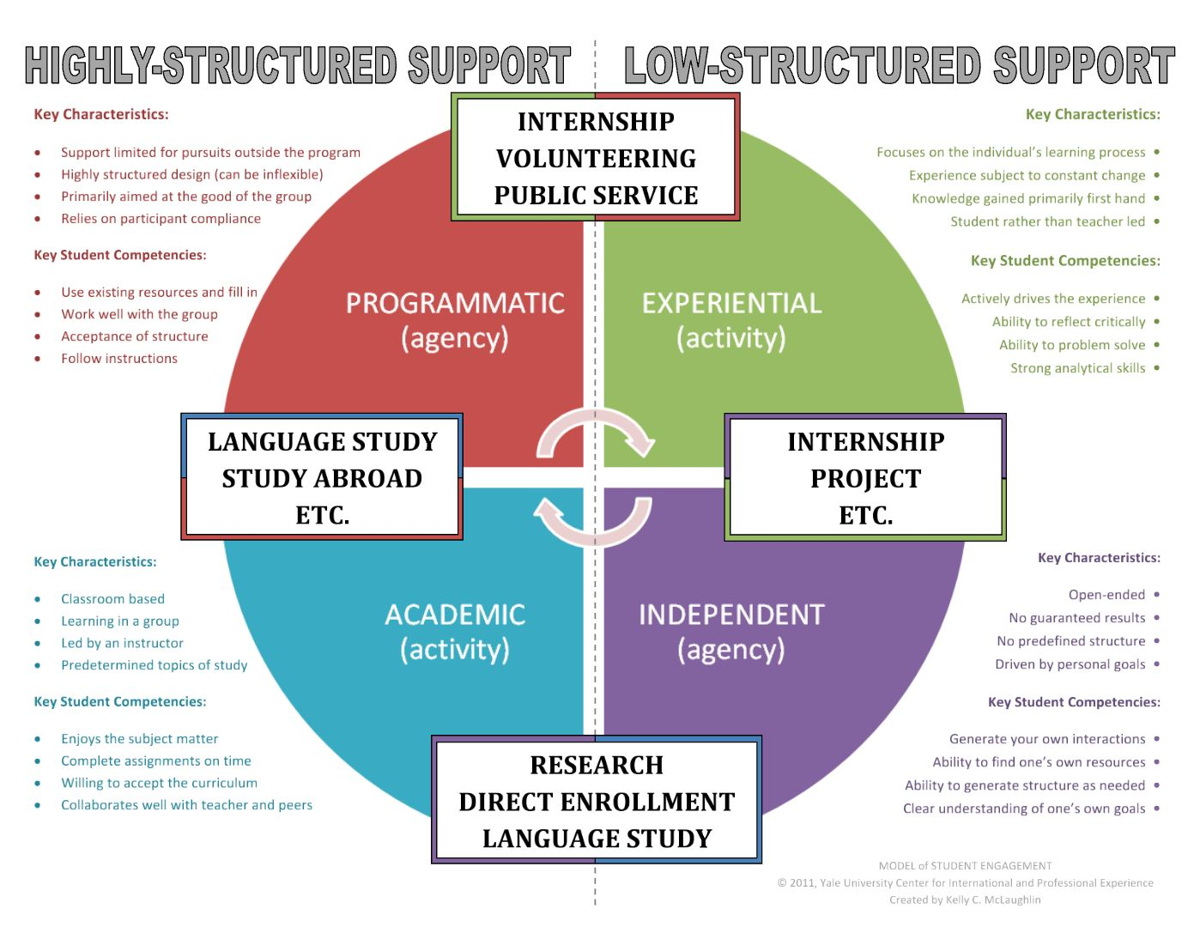
What kind of experience are you engaging in?
Think about it and think about what competencies you’ll need to make that experience successful.
Notes:
Another way to prepare for your experience is to think deeply about what experience you are actually engaging in; if you do this and are able to slot your experience into one of our four buckets, you’ll be able to get a sense of what to expect and what characteristics you should be bringing to the environment.
Is your experience programmatic? This likely means it is highly structured and geared towards a group. You will want to make sure you are able to follow instructions and handle potentially inflexible environments. What about experiential? You might be leading this and the experience could change constantly; you’ll want to make sure you can problem solve and use analytical skills to stay on target. Is the experience Academic? Hopefully, if it is, you enjoy the subject matter you will be studying and will collaborate with your teachers and peers in a classroom based environment. Lastly, if your experience is Independent, it may not have any pre-defined structure at all, nor will it have guaranteed results; in these cases you’ll need to do a lot of thinking about your own interactions and goals to make the most of the experience.
It’s important to note that your experience may also be a combination of these buckets. Take a look at the chart to figure out where you would place yourself and your experience and then take a look at the key characteristics and student competencies. If you feel weaker in any area, perhaps now is a good time to enhance those skills! At the very least, you won’t be caught off guard when some of those things are expected of you on your experience if you do the thinking now!.

Slide 10
Set Goals
Connections
What kind? Why?
Industry/Field Knowledge
What type of information? Why?
Research Outcomes
How much data/information collected? Write a paper?
Cultural Engagement
What type of engagements? Why?
Notes:
Regardless of the experience you are embarking on, you want to make sure you set goals for yourself. Most goals will fall under these four buckets: connections, industry or field knowledge, research outcomes, and cultural engagement. Make a list of some of the questions you want to answer for yourself in each of these buckets and be intentional about seeking those answers while you are engaging in your experience.

Slide 11
Goals Chart
Notes:
This Goals Chat can be a helpful tool to keep you on task when it comes to your own personal goals as they are related to the buckets on the previous slide. Perhaps you are hoping to get a better handle on the language of your host country or space; maybe there are personal goals you have related to embarking on an experience such as this alone. Whatever they are, take some time to write them down, what progress in those goals would look like to you at three different intervals, and then how exactly you will measure that progress. Lastly, you’ll want to make sure you keep a list of the tools and resources you already have at your disposal to accomplish those goals.
Continue to revisit this goals chart throughout your experience and don’t be discouraged if things don’t always work out the way you plan! Goals can grow, change, and develop over the course of your experience, but this will only be beneficial to you if you are constantly reflecting on your journey.

Slide 12
Critical Reflection
Frequently check in with yourself about the goals and action items you’ve set
Always ask “Why?”
Take fewer pictures; live in the moment!
Notes:
So, frequently check in with yourself. How are you feeling about the experience? Are there things you still haven’t gotten to do that you want to make sure you accomplish before the conclusion of your experience? Are there still connections you need to make? Keep your goals list handy and always look back to it for inspiration.
Also, always ask WHY! This is the best way to learn from others and yourself. Why are you going to this museum; why are you studying that subject; why are you talking to this particular person; always ask Why
And lastly, remember to live in the moment. Yes, pictures are great and you will want to take some to remember this, but there is nothing like experiencing things in the moment they are happening. Don’t be afraid to put down your camera or phone and just enjoy and experience the world around you.

Slide 13
How to Keep Track
Think of starting a blog or personal journal (or both!)
Ask yourself questions in advance/give yourself personal homework
Blog Links:
FutureMe.org
stickK.com
Notes:
At this point of the presentation, we’ve gone over preparation, mindful engagement, setting goals, and reflecting. Sometimes, it can be helpful to use tools to help you keep track of all of these things while you are on your experience. To help you keep track, you might want to start a personal blog or journal; make it a point to write about your days and the things you experience. Not only will this help you reflect; it will also be a fun token to look back on at the conclusion of your experience.
Another idea is to make yourself a list of questions or personal homework while you’re away; perhaps there are prompts you want to answer for yourself each day; maybe there are thematic goals for each week. Think about what you want to get out of the experience and go from there.
Lastly, there are a few pre-designed blogs that help you get started if you aren’t quite sure where to start. FutureMe.org allows you to write e letter to your future self that you can revisit at the end of your experience; it could be fun to see what you were hoping for at the beginning and how you changed and grew by the end.
Stickk.com allows you to set goals for yourself and helps you keep track of your own progress.
There are tons of other things out there, but the important thing is to make sure you find a way of keeping track that works for you! Maybe you want to start a social media series; perhaps you want to take a photo diary; maybe you want to food blog while you’re away; whatever it is, make sure you keep track of your experience!

Slide 14
Health & Safety
Use ISOS location guides and planning services
Plan ahead for vaccinations – some need to be administered several weeks before travel
Travel clinics – Yale and Passport Health
Yale Health Plan is minimal – you may need additional travel health coverage
YC3 Wellness
Notes:
This last part of the presentation will concentrate on health and safety. No matter where you are traveling, you want to make sure you keep these things in mind. Plan ahead and do your research so that you can feel confident in any health and safety situations.
Download the International SOS application to gain access to location guides and planning services in your location. You can also check vaccination requirements and make sure you are up-to-date on any necessary medications. Consider whether you will have access to the medications/treatments you need and whether there are any restrictions on crossing borders with medication. Also, similarly, consider how a change in routine/time zone/diet/or environment might impact your specific health conditions and needs.
Take a look at local travel clinics and get to know your Yale Health Plan and Passport Health.
Make sure your travel health coverage works for you. Yale Health Plan might be minimal while you are away, so make sure your health coverage works for you and your needs for the duration of your experience.
Important to note that ISOS includes up to 5 counseling sessions which may be offered remotely/or in person. Additional sessions may also be possible depending on circumstances. You also still have access to the Community Wellness Specialists through YC3 while abroad. They can talk to you about a number of things including stress management, communication skills, identity development, time management, LGBTQIA+ matters, approaching difficult conversations, mindfulness, self-compassion, boundaries, relationships, and more.
Most importantly, do your research and review the resources on our pre-departure pages for more in-depth information on health and safety measures before and during your experience.

Slide 15
Safety
Know the local “911”
Contact ISOS in any emergency – they can offer immediate country-specific assistant and local resources
1-215-942-8478
Contact Yale if necessary
SHARE is available to you off-campus
1-203-432-2000
Familiarize yourself with local laws and customs
Have copies of credit cards and other important documents
Notes:
Things happen and emergencies might come up. In the case of an emergency, make sure you know the local “911” number. Contact ISOS in any emergency. Call them FIRST; Anyone can also contact ISOS on your behalf if needed. By calling in advance, ISOS can direct you to an appropriate medical care provider and set up a guarantee of pay so that you do not need to pay out-of-pocket. Always mention that you are a Yale student on Yale business. If you do not call ahead of time, you may be responsible for covering any associated costs out of pocket. However, if it life threatening, please seek immediate care and ISOS will sort it out.
Contact Yale if necessary; more information about contacting Yale in an emergency abroad can be found on our pre-departure pages. Know that various campus resources such as SHARE are still available to you even off-campus. Make sure you are away of the local laws and customs in your given area before you go; you want to make sure you do not put yourself in any unsafe or illegal situations.
And lastly, keep copies of all important documents while traveling. Things can get lost or stolen and you want to make it as easy as possible to replace anything in the case of an emergency.

Slide 16
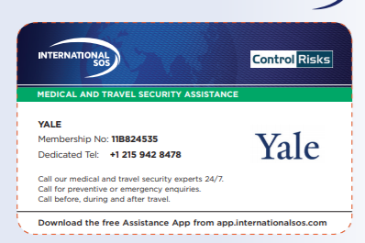
International SOS
Emergency and routine medical, security, and travel assistance services while 100+ miles away from your permanent residence
Includes Out-of-Country Medical Care Coverage for illness and injury up to $250,000 for the duration of your experience
Purchasing additional travel and health insurance is always recommended
Notes:
Some of you may not know much about International SOS. ISOS provides emergency and routine medical, security, and travel assistance services while 100+ miles away from your permanent resident; it includes out of-country medical care coverage. As always, we recommend purchasing additional travel and health insurance as needed. You can find more information about Yale’s ISOS membership on the card on the right of this slide.

Slide 17
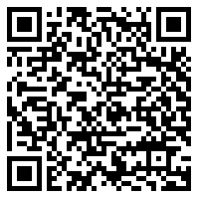
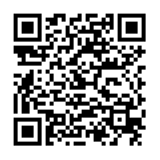
ISOS App
Notes:
Download the ISOS App now, while you are watching the presentation. The QR card on the left is for the Google Play store while the right QR code is for the app store. Make sure you download the application in advance.

Slide 18
ISOS: Before You Leave
Take or download
Take or download ISOS card
Make note of Member Number: #11B824535
Always mention that you are a Yale student traveling on Yale business
Download
Download ISOS App Now: www.internationalsos.com/assistance-app
Visit
Visit the ISOS Online Member Center
Call
Call the dedicated ISOS number before you go to discuss your trip:
1-215-942-8478
Share
Share information about ISOS with your family
Notes:
Make sure you do the following things on the application before you leave. Make note of your member number; ALWAYS mention that you are a Yale student traveling on Yale business regardless of whether this is a summer experience, term time experience, or a postgraduate one. Download the app! Visit the ISOS Online Member Center. Call ISOS to discuss your trip and most important, share ISOS with your family or any other important people in your life.

Slide 19
Have fun!
Most importantly, enjoy this experience. And remember, we’re here to answer any questions before you embark on your journey!
fellowships@yale.edu
Notes:
Thank you for taking the time to watch this pre-departure presentation and remember, we’re here to answer any questions before you embark on your journey. Have fun and enjoy your experience!

