Slide 1
How to Change Applicant Status
1. Log in using your NetID
https://yale.communityforce.com

Slide 2
2. Enter NetID and password
3. CAS log in
Change Applicant Status Tutorial

Slide 3
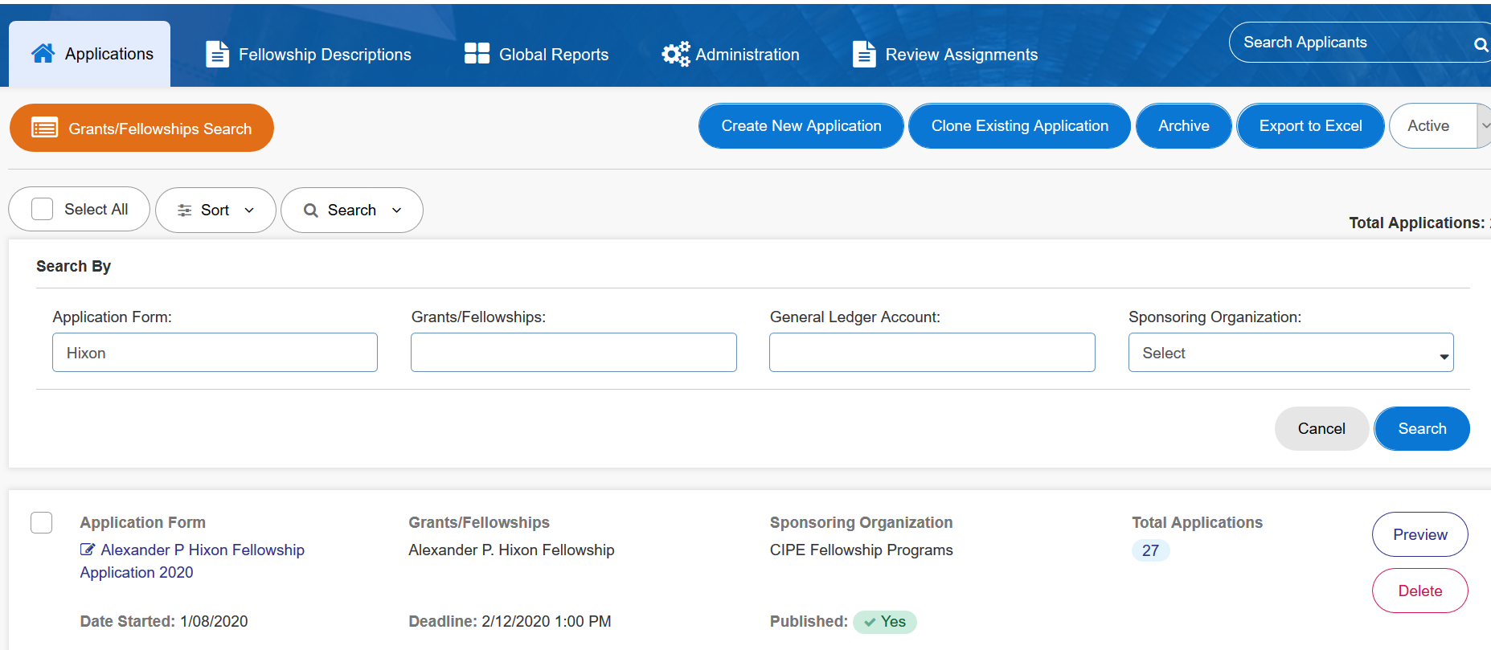
4. In the “Applications” tab, select the appropriate application
Change Applicant Status Tutorial

Slide 4
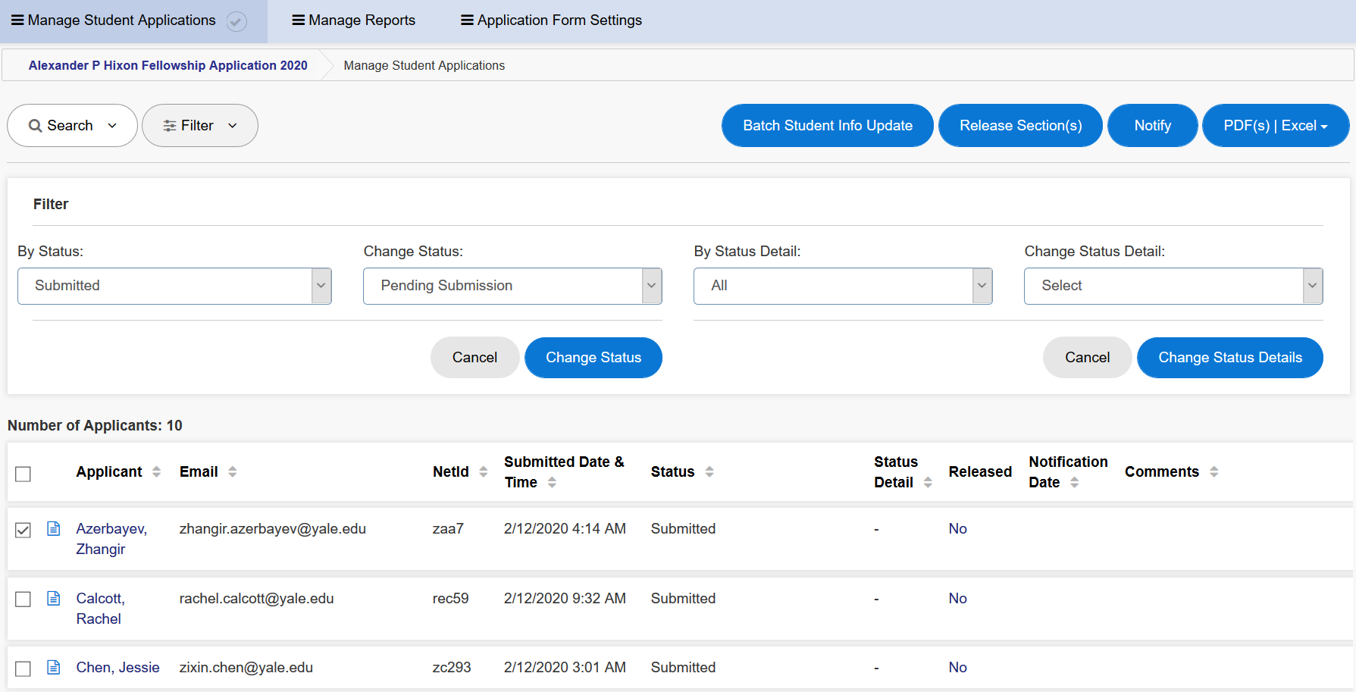
5. Select “Filter” to display status options
6. Use the drop-down menu to select the status you want to change
9. Click on “Change Status”
7. Check the box next to the applicant whose status you need to change
8. Select the new status from the drop-down menu
Change Applicant Status Tutorial

Slide 5
Questions? Please contact the Yale Student Grants team with any questions: studentgrants@yale.edu.

